Slide 1
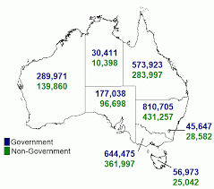
Project Title: Schools Australia
Team members
Hesh Kuruppuge
Jasjeet Kaur
Yao Ding
Aravind Sama
DATA SOURCE: ABS Schools Australia
A map of Australia showing student enrolment counts by state and territory and affiliation for 2020

Slide 2
Research Purpose
To look at student enrolment trends in public and private education system in Australia at a National and
state or territory level
Research Questions
1. What is the number and percentage of student enrolment by state in last 5 years (2016-2020) by state?
2. How does indigenous and non indigenous enrolment differs in each state/territory in last 5 years (2016-2020)
3. Is there a difference in student enrolments pre (2018) and post (2020) pandemic period?
4. What is the number and percentage of student enrolment by affiliation in last 5 years (2016-2020) nationally and by state/territory?
5. What is the trend in student enrolments for last 15 years for each Australian state/territory?

Slide 3
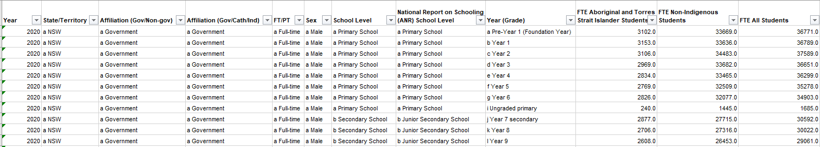
Data Source
ABS Schools Australia
ABS National, state and territory population
NSW government website
Australian Bureau of Statistics
Schools, 2020
Data on students, staff, schools, rates and ratios for government and non-government schools, for all Australian states and territories (60 kB)
Link to the data set
https://www.abs.gov.au/statistics/people/education/schools/latest-release
Table 43a was used
Table: 43a –14,000 R X 12 C

Slide 4

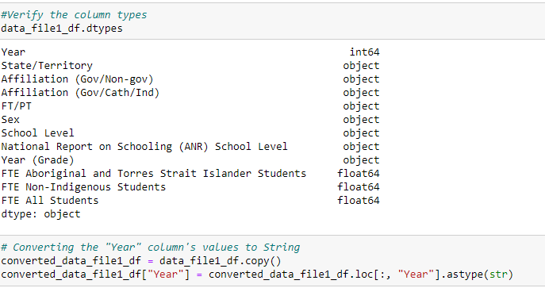
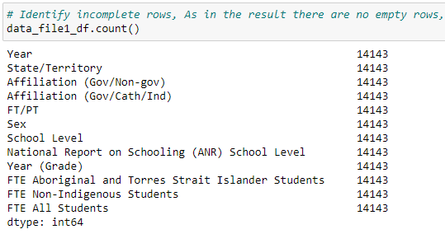
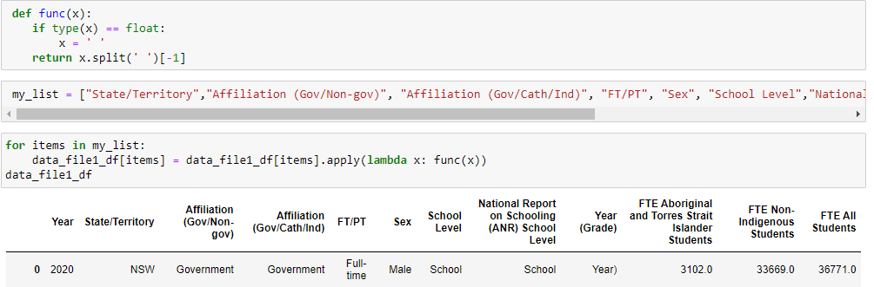
Data exploration and clean up
Jupyter notebook link
Read raw data from excel file
3. Checked the data types and converted year from integer to string
2. Screened for any empty rows
4. Removed prefixes in each column

Slide 5
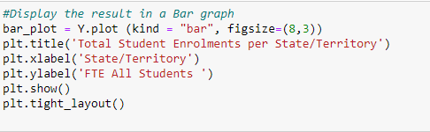
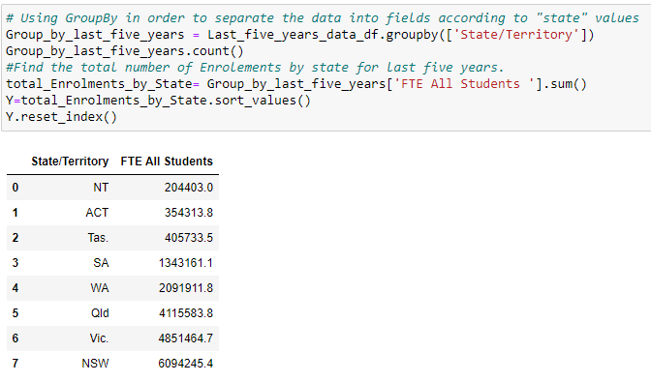
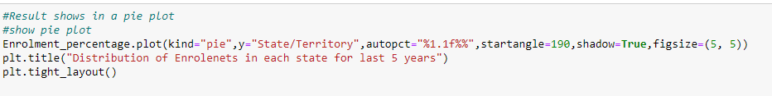

Data analysis process
Jupyter notebook link
Filtered data based on year to get last five years data (2016-2020)
3. Created a Bar Graph from grouped data
2. Grouped variables and sorted values
4. Created a Pie Chart to calculate the percentage of student enrolment in grouped data
5. Created a scatter plot to look at the trend of student enrolment in each state

Slide 6
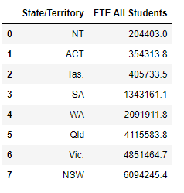
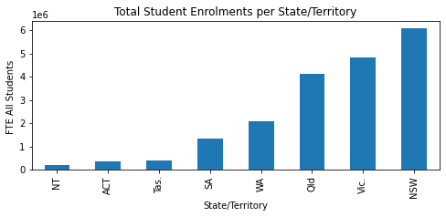
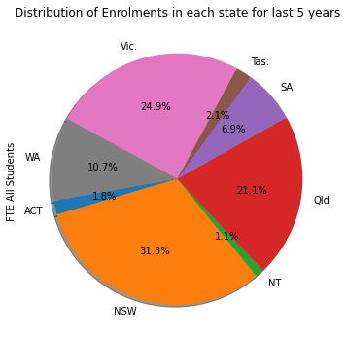
Numerical summary and visualisations
1. What is the number and percentage of student enrolment by state/territory in last 5 years (2016-2020)?
Table 1
Figure 1a: Bar chart
Figure 1b: Pie chart
NSW and Victoria have the highest number of student enrolments in last five years
NT and ACT have the lowest number of student enrolments in last five years
Creating a write-up summarizing your major findings. This should include a heading for each “question” you asked of your data and a short description of your findings and any relevant plots.
Notes:
Our first research question was to find the number and percentage of student enrolments by state/territory in last five years? Table 1 presents the numerical summary of total student enrolments in each Australian state which was plotted in a bar chart (Figure 1a) which shows that NSW and Victoria have the highest number of student enrolments while NT and ACT have the lowest number in last five years.
The percentage of total student enrolments in each state was also presented in a pie chart as shown in Figure 1b.

Slide 7
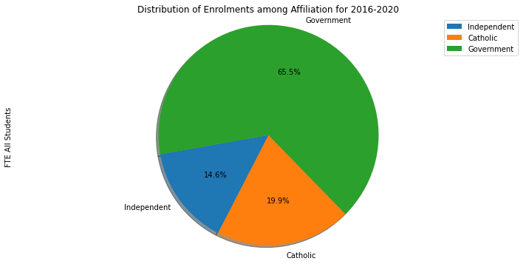
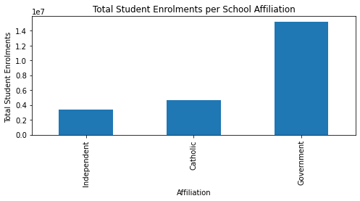
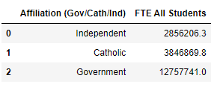
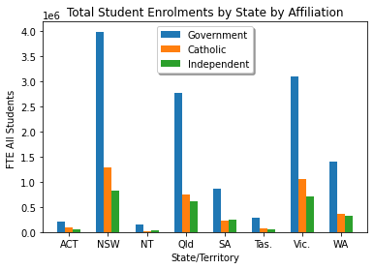
Numerical summary and visualisations
2. What is the number and percentage of student enrolment by affiliation in last 5 years (2016-2020) nationally and by state/territory?
Table 2
Figure 2a: Bar Chart
Figure 2b: Pie Chart
Nationally, government schools have higher student enrolments than non-government schools (catholic and independent)
In all Australian states/territories, government schools have higher student enrolments than non-government schools (catholic and independent)
Figure 2c: Bar Chart
Notes:
Our second question was to find the number and percentage of student enrolment by affiliation in last 5 years (2016-2020) nationally and by state/territory?
Table 2 presents the numerical summary of student enrolments nationally based on school affiliation i.e. catholic, independent and government schools in the last five years which is also presented in Figure 2a as a bar chart and Figure 2b as a pie chart which shows that Nationally, government schools have higher student enrolments than non-government schools (catholic and independent).
Figure 2c shows a bar chart comparing the student enrolments in different states by affiliation. In all Australian states/territories, government schools have higher student enrolments than non-government schools (catholic and independent)

Slide 8
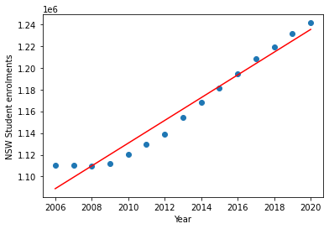
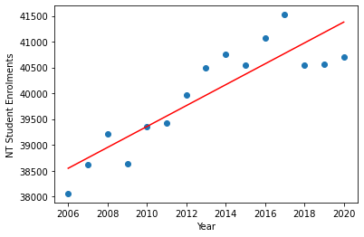
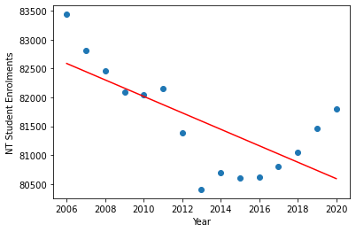
Numerical summary and visualisations
3. What is the trend in student enrolments for last 15 years for each Australian state/territory?
Is there a difference in student enrolments pre (2018) and post (2020) pandemic period in NSW, NT and Tas?
The r-squared is: 0.960784825711232
The r-squared is: 0.78517497932712
The r-squared is: 0.4904618341953918
NSW
NT
Tas
'y = 10453.16x + -19880190.75'
'y = 202.34x + -367341.94'
'y = -142.38x + 368205.47'
Figure 3a: Scatter plot
Figure 3b: Scatter plot
Figure 3c: Scatter plot
The student enrolments in 2030 for NSW will be 1339729.85.
The student enrolments in 2030 for NT will be 43402.46.
The student enrolments in 2030 for Tas will be 79168.99
Linear regression analysis for forecasting student enrolments
Student enrolments have continued to increase despite of the pandemic
Creating a write-up summarizing your major findings. This should include a heading for each “question” you asked of your data and a short description of your findings and any relevant plots.
Notes:
Our third question was to see the trend in student enrolments for last 15 years for each Australian state/territory? And also to find out if there a difference in student enrolments pre (2018) and post (2020) pandemic period.
To visualise this we made scatter plots. Figure 3a is a scatter plot shows an exponential increase in the number of student enrolments in last 15 years for NSW. In NT

Slide 9
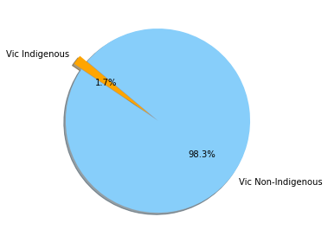
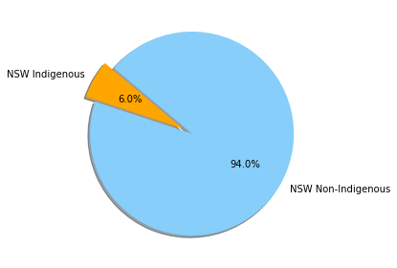
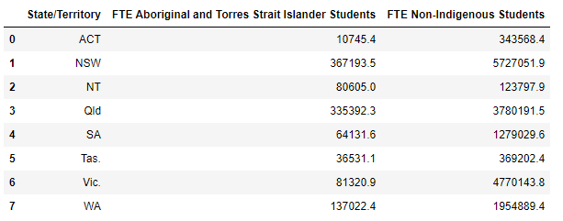
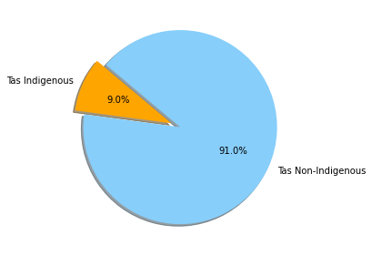
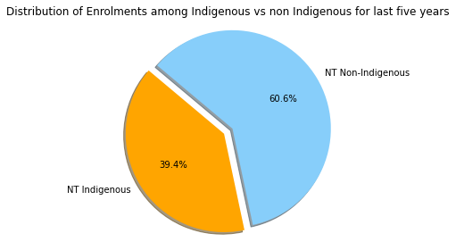
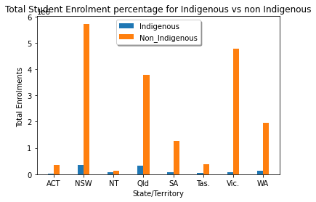
Numerical summary and visualisations
4. How does indigenous and non indigenous enrolment differs in each state/territory in last 5 years (2016-2020)?
Table 4
Figure 4a: Pie Chart
Vic has the lowest proportion of indigenous enrolments and NT has the highest
Proportion of indigenous enrolments
Vic, ACT, SA (1-5%)
NSW, WA, Qld, Tas (5-10%)
NT (40%)
Figure 4b: Bar Chart

Slide 10
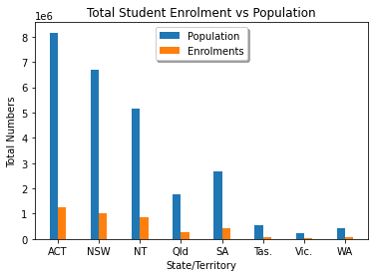
Numerical summary and visualisations

Slide 11
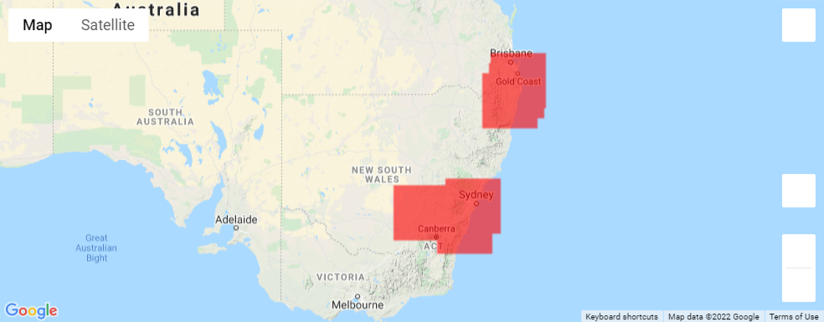
Numerical summary and visualisations

Slide 12
The implications of your findings: What do your findings mean?
NSW and Victoria have the highest population, therefore the percentage of student enrolments in these states are the highest
Measures should be taken by governments of Victoria, ACT and SA to increase the enrolment of Indigenous students in the schools
Student enrolments in Tasmania show a decline in 10 years from now, therefore measures should be put in place to prevent this from happening

